Slide 1
Today
Lecture 8: BCS theory --- Attractive interaction and the BCS wavefunction and ground state
Discussion the BCS theory in four parts:
Clues to the mechanism and the Cooper instability problem
Attractive interaction and the BCS wavefunction and ground state
Self-consistent solution and quasiparticles
Thermodynamics, electrodynamics, and the coherence factors
Next time
Lecture 9: BCS theory --- Self-consistent solution and quasiparticles

Slide 2

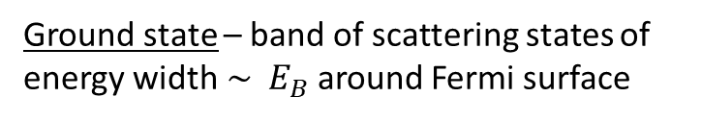
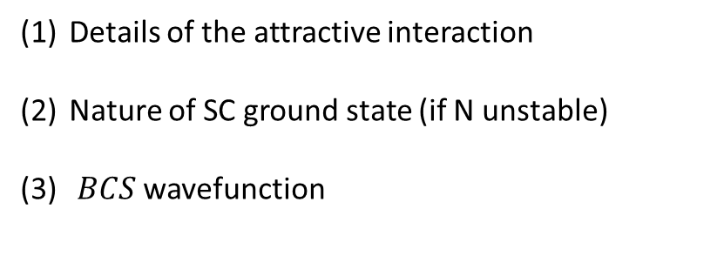


Last time:
Cooper Instability
Attractive for $\left|ξk\right|<ℏωc$
$$E_{B}=2ℏωc e^{− \frac{2}{N\left(0\right)V} }$$
$$(N\left(0\right)V≪1)$$
weak coupling
Need filled FS to get lots of available states for scattering
Today:
Details of the attractive interaction
Nature of SC ground state (if N unstable)
$BCS$ wavefunction
Ground state – band of scattering states of energy width$\sim E_{B}$around Fermi surface

Slide 3
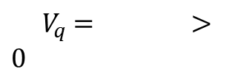







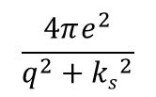



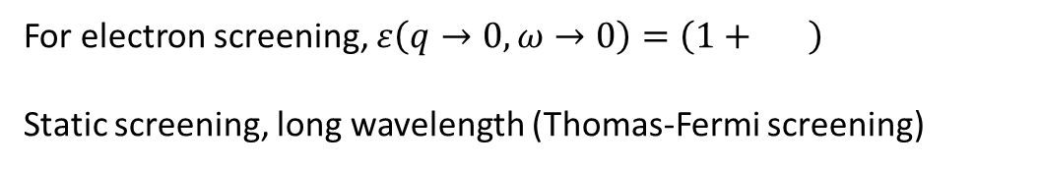




Electron – Phonon Interaction
Frӧlich (1950)
Pines
1950’s
Bardeen
Electrons repulsive (long range)
$${ V}_{k,k′} = \left\langle \left.\overline{k′},−\overline{k′}\right|\left.V(\overset{⃑}{r})\right|\overline{k},−\overline{k}\right\rangle$$
$$e^{−i\overset{⃑}{k^{′}}r} \left(\frac{e^{2}}{r}\right) e^{i\overset{⃑}{k}\overset{⃑}{r}}$$
$$\frac{4πe^{2}}{q^{2}}$$
$$\overset{⃑}{q}= \overset{⃑}{k} − \overset{⃑}{k}′$$
“bare Coulomb repulsion”
${ V}_{q}$ $= >0$
for
Add in screening by electrons and ions:
In general, define $ε(q,ω)$ “dielectric function”
$\frac{e^{2}}{r} e^{−ksr}$
$$\frac{4πe^{2}}{q^{2}+{ks}^{2}}$$
$$\left(\frac{4πe^{2}}{q^{2}}\right) \frac{1}{ε(q,ω)}$$
1st electrons:
$$V\left(\overset{⃑}{r}\right)=$$
$${⇒ V}_{q}=$$
$>0$
$$Vq=$$
Interaction is cutoff at short q (long λ)
$$\frac{ks^{2}}{q^{2}}$$
For electron screening, $ε\left(q→0,ω→0\right)=\left(1+ \right)$
Static screening, long wavelength (Thomas-Fermi screening)
$$\frac{1}{ks}$$
$(λ= =$screening length)
Still repulsive $⇒$ no $SC$

Slide 4





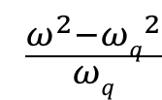




2nd ions:
Static ions --- no response to an electron
$$+$$
$$+$$
Dynamic ions --- ions respond slowly but if driven at phonon frequency there is a resonance
e⁻
Effective residual positive charge attracts the electron
$$+$$
$$+$$
+
“direct repulsive force”
Dynamical “phonon-mediated” electron-phonon interaction --- not a static e-e attraction
“retarded attractive force”
Both electrons and ions: $Vq=$
$$\frac{{4πe}^{2}}{q^{2}+{ks}^{2}} (1+ \frac{ωq}{ω^{2}−{ωq}^{2}})$$
$$\frac{ω^{2}−{ωq}^{2}}{ωq}$$
$$ε\left(\overset{⃑}{q}, 0 \right) ≈εs\left(\overset{⃑}{q},0\right)$$
balance between Coulomb repulsion and electron-phonon coupling
attractive
repulsive
$ωq$= resonance frequency
BCS attractive potential (cutoff not critical)

Slide 5





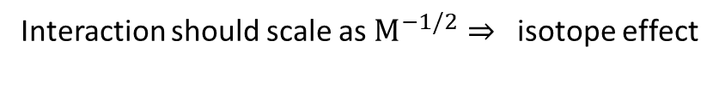





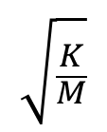






$$\sqrt{\frac{K}{M}}$$
(2) What is $ωq ?$
$$ωq \sim$$
vibrational or phonon equency
$$M$$
$$K$$
ion mass
Interaction should scale as $M^{−1/2}⇒$ isotope effect
If electron-phonon coupling is strong (bad conductor at room T), $Vq$large ….. good for SC
There are more accurate forms, but the model is not very sensitive except for getting numerical values for $Tc$
These can include:
band structure
material parameter (e.g. elastic constants, phonon structure …)
finite ion cores
Biggest changes at low $ω ⇒$more attractive !
BCS model --- expressed in terms of 2nd quantization operators:
$c_{kσ}^{+}$ creation
creates an electron at momentum (wavevector)
and spin
$$k$$
$$σ$$
$$σ$$
$c_{kσ}$ annihilation
$$k$$
and spin
annihilates an electron at momentum (wavevector)
Fermions : anti-communication
$\left[c_{kσ}^{+},c_{k^{′}σ′}^{+}\right]=c_{kσ}{c_{k′σ′}^{+}}_{ }+c_{kσ}^{+}c_{kσ}$
$$=δkk^{′} δσσ′$$
$$\left[c^{+}c^{+}\right]=\left[c, c\right]=0$$
$N_{k,σ}= c_{kσ}^{+}c_{kσ}$ Number operator

Slide 6
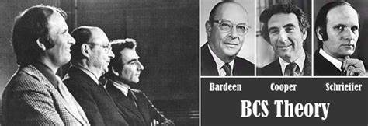
BCS Theory (1957)
Solved the problem of superconductivity --- simplified the model enough to be soluble
BUT
kept the essential physics

Slide 7
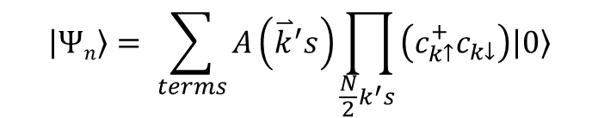

BCS model
Assume ground state will consist of paired states ($\overset{⃑}{k},−\overset{⃑}{k})$ with singlet spin-pairing --- most general form:
$$\left|Ψ\right.\left.n\right\rangle = \sum_{terms}{A\left({\overset{⃑}{k}}^{′}s\right)}\prod_{\frac{N}{2}k^{′}s }{\left(c_{k↑}^{+}c_{k↓}\right)\left|\left.0\right\rangle \right.}$$
Fill states $\overset{⃑}{k},−\overset{⃑}{k}$ until N electrons.
Can do that $\frac{M!}{\left(M−\frac{N}{2}\right)!(\frac{N}{2})!}≈{10}^{N}≈ {10}^{({10}^{22})}$ ways, which is also the number of terms and coefficients
*BCS used a Hartree self-consistent field or mean field approximation:
this assumes that each electron-pair state depends on an average over other states
Hartree approximation is critical for reducing many-body electron problems to single electron states
Consequence – electron-pair state occupancy depends on averaged quantities, which relaxes the constraints on the number and occupancy of all states filled at any instant (“grand canonical ensemble”)

Slide 8


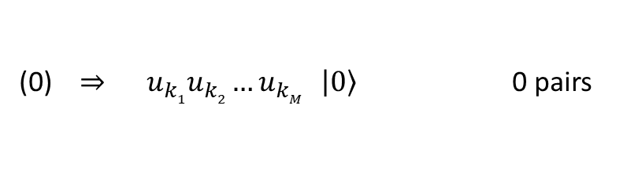

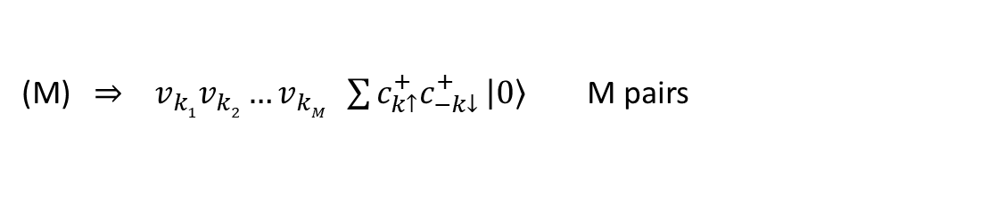
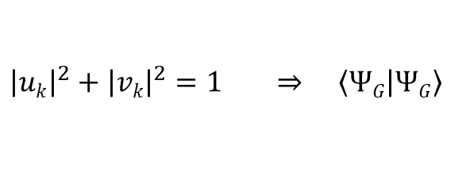
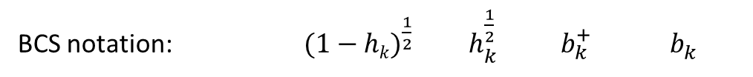

BCS wavefunction
Generate BCS ground state by adding pairs to the vacuum state
BCS notation: $(1−hk)^{\frac{1}{2}} h_{k}^{\frac{1}{2}} b_{k }^{+}$ $b_{k}^{ }$
Bogoluibov notation is generally used
Bogoluibov notation:
$$uk$$
$$vk$$
$uk, vk$ are complex (same relative phase for all $k)$
important
$${\left|uk\right|}^{2}+{\left|vk\right|}^{2}=1 ⇒ \left\langle ΨG\left|ΨG\right.\right\rangle$$
${\left|vk\right|}^{2} =$probability that the pair state $\overset{⃑}{(k},−\vec{k}$) is occupied
${\left|uk\right|}^{2} =$ probability that the pair state $\overset{⃑}{(k},−\vec{k}$) is $e$mpty
consists of terms with different numbers of electrons:
(0) $⇒ u_{k1}u_{k2}…u_{kM } \left|\left.0\right\rangle \right.$ 0 pairs
(M) $⇒ v_{k1}v_{k2}…v_{kM} \sum{c_{k↑}^{+}c_{−k↓}^{+}}\left|\left.0\right\rangle \right.$ M pairs
$$k^{′}s$$
Filled band (all states)

Slide 9
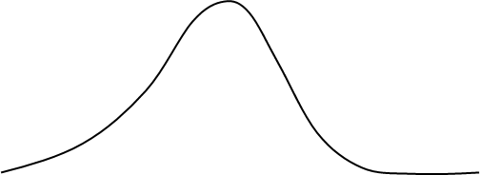
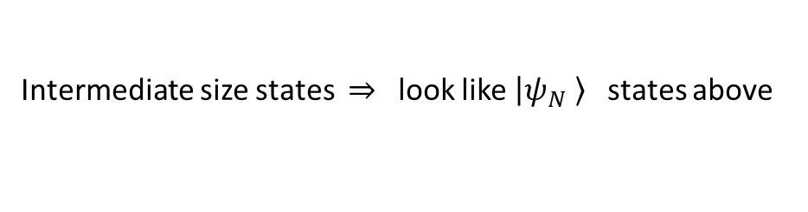
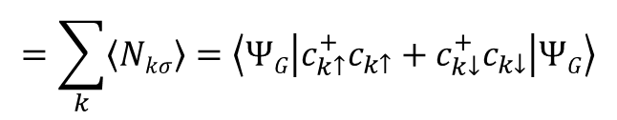
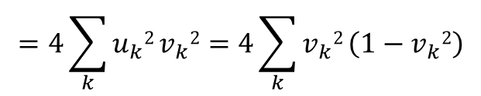


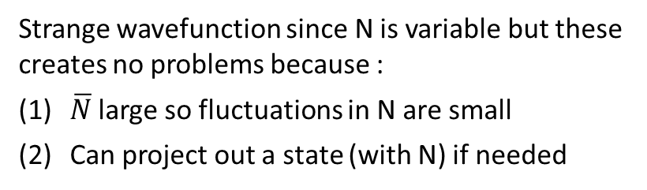

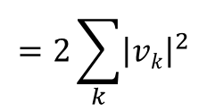
Intermediate size states $⇒$look like $\left|ψ_{N}\left. \right\rangle \right.$ states above
Strange wavefunction since N is variable but these creates no problems because :
$\overline{N}$ large so fluctuations in N are small
Can project out a state (with N) if needed
A(k’s)
$$=\sum_{k}{\left\langle Nkσ\right\rangle }=\left\langle ΨG | c_{k↑}^{+}c_{k↑}+c_{k↓}^{+}c_{k↓} | ΨG\right\rangle$$
$$=2\sum_{k}{{\left|vk\right|}^{2}}$$
(mean)
$$=4\sum_{k}{u_{k}2}v_{k}2=4\sum_{k}{v_{k}2}\left(1−v_{k}2\right)$$
(variance)
$δN2rms=\left\langle (N−\overline{N})^{2}\right\rangle = \left\langle N^{2}\right\rangle − {\overline{N}}^{2}$
$$δN2rms$$
State with few or many particles are unlikely --- deviations small
$$δN_{rms}= \left\langle (N−\overline{N})^{2}\right\rangle ^{\frac{1}{2} } \sim {\overline{N} }^{\frac{1}{2} } \sim {10}^{10}$$

Slide 10
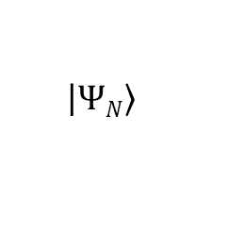

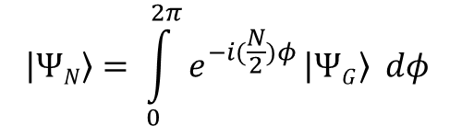
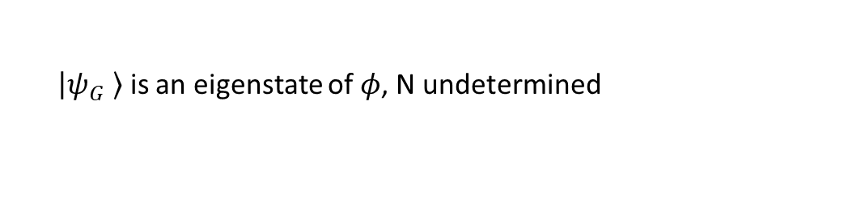

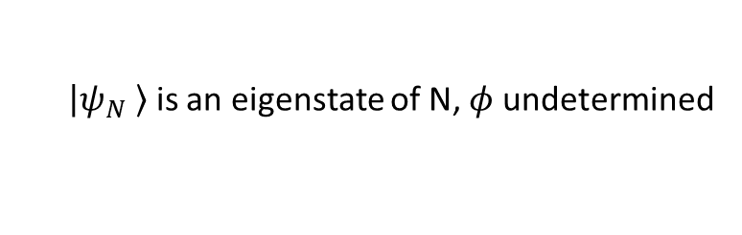
Projection (via phase)
phase fixed
phase factor
$N$electrons
$$\left.\left|ΨN\right.\right\rangle = \int_{0}^{2π}{e^{−i(\frac{N}{2})φ}}\left|\left.ΨG\right\rangle dφ \right.$$
Projects out
$$\left|\left.ΨN\right\rangle \right.$$
$\left|ψ_{G}\left. \right\rangle \right.$ is an eigenstate of $φ$, N undetermined
Uncertainly relation:
$$∆N ∆φ ≥1$$
$\left|ψ_{N}\left. \right\rangle \right.$ is an eigenstate of N, $φ$ undetermined

Slide 11


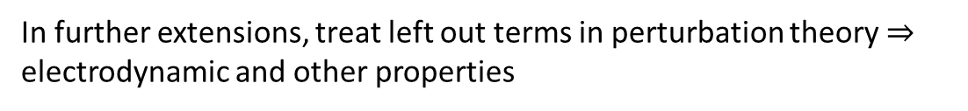

Hamiltonians
Besides choosing a specific form for the wavefunction, BCS also simplified the Hamiltonian:
General H (interacting electrons):
$$\overset{⃑}{ℓ}=\overset{⃑}{q}+\overset{⃑}{k}$$
Could allow spin flip scattering
$${\overset{⃑}{ℓ}}^{′}= \overset{⃑}{q}+ \overset{⃑}{k}′$$
BCS pairing (“reduced”) H:
V_{q}
Same as Cooper in 2nd quantization form
Keep terms allowing interactions between paired electrons only. Terms left out are same in normal metal.
$$\overline{k}+\overset{⃑}{q}=\overset{⃑}{ℓ}$$
In further extensions, treat left out terms in perturbation theory $⇒$ electrodynamic and other properties

Slide 12


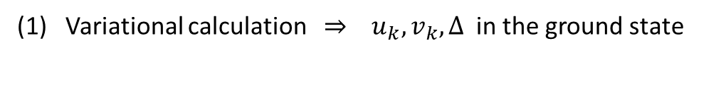

BCS ground state:
$${\left|uk\right|}^{2}+{\left|vk\right|}^{2}=1$$
Eigenstate of $θ$ so N is indeterminate
BCS (reduced) H:
We will solve this in two ways:
(1) Variational calculation $⇒ u_{k}, v_{k}, Δ$ in the ground state
(2) Diagonalize H $⇒$ excitation spectrum

Slide 13
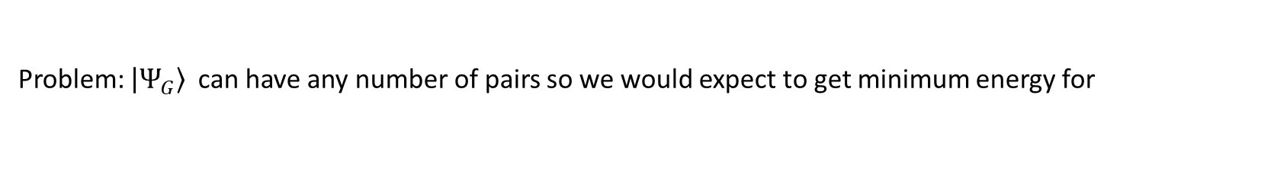




Variational Calculation
Problem: $\left|\left.Ψ_{G}\right\rangle \right.$ can have any number of pairs so we would expect to get minimum energy for
Solution: constraint on N by use of a Lagrange multiplier
$HBCS →HBCS− μ\overline{N}$
measure energies with respect to μ so $ε_{k}→ξ_{k}$
For a particular k and :
$u_{k}v_{ℓ}$ = initial
$u_{ℓ}^{∗}v_{k}^{∗}$ = final
kinetic energy
pairing interaction

Slide 14
Solution:
Assume that the and real
minimize each term

Slide 15
EQUATIONS
SOLUTION
where
and
Then:
1

Slide 16

Gap equation
Iterative equation
BCS form of the potential:
(similar to Cooper potential but spread across E_{F})
Δ same for all states
(NB: isotropic interaction leads to isotropic gap)X
BCS:
BCS
Weak coupling
Cooper:
Cooper
$$\left(E_{B}≪Δ\right)$$

Slide 17
Condensation Energy
spin
Normal State:
SC State:
since
0
“effective pairs” = pair condensation amplitude
weak coupling

Slide 18
Condensation energy
Delicate balance between
Typically,
Cooper idea right – excite above to get paring interaction until no benefit
BCS ground state

